Slide 1


AtliQ Mart Sales/ Promotions Analysis
Presented by
Sidhant Bisht

Slide 2
Problem Statement
AtliQ Mart, a prominent retail giant, operates 50 supermarkets across the southern region of India.
During the festive periods of Diwali 2023 and Sankranti 2024, AtliQ Mart conducted extensive promotions on their AtliQ branded products across all 50 stores.
The Sales Director is seeking a comprehensive analysis to distinguish the success levels of these promotions.
The primary objective is to identify the promotions that performed well and those that did not, enabling informed decision-making for future promotional strategies.

Slide 3
Objective
Evaluate the success of AtliQ Mart's Diwali 2023 and Sankranti 2024 promotions.
Identify factors contributing to the effectiveness of each promotion.
Provide insights for informed decision-making in future promotional planning.
Optimize resource allocation based on the analysis for enhanced performance.

Slide 4



Dashboard

Slide 5
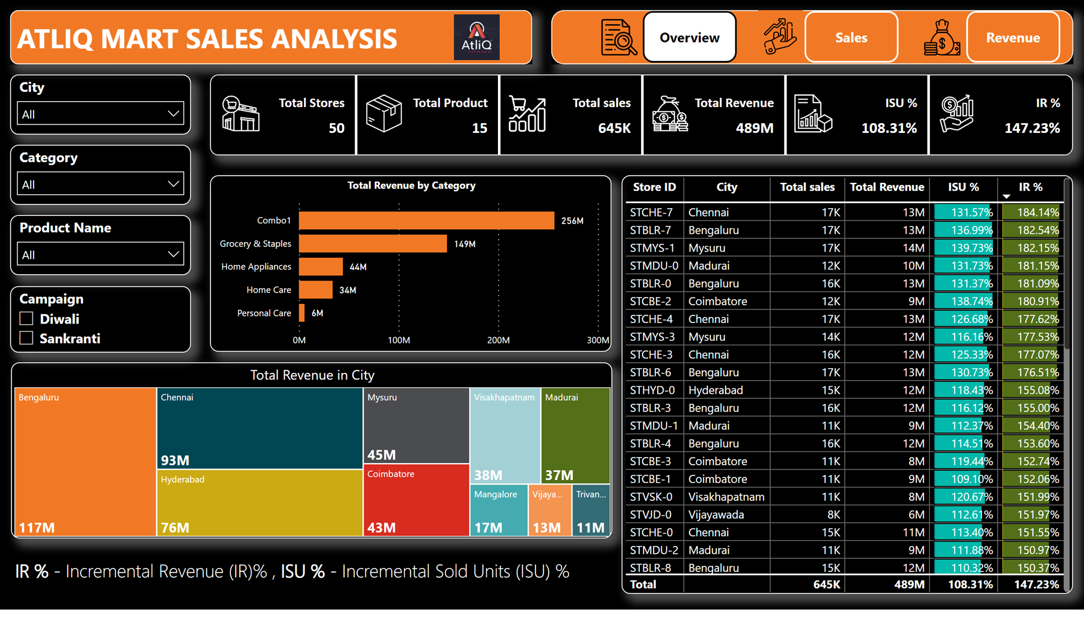

Slide 6
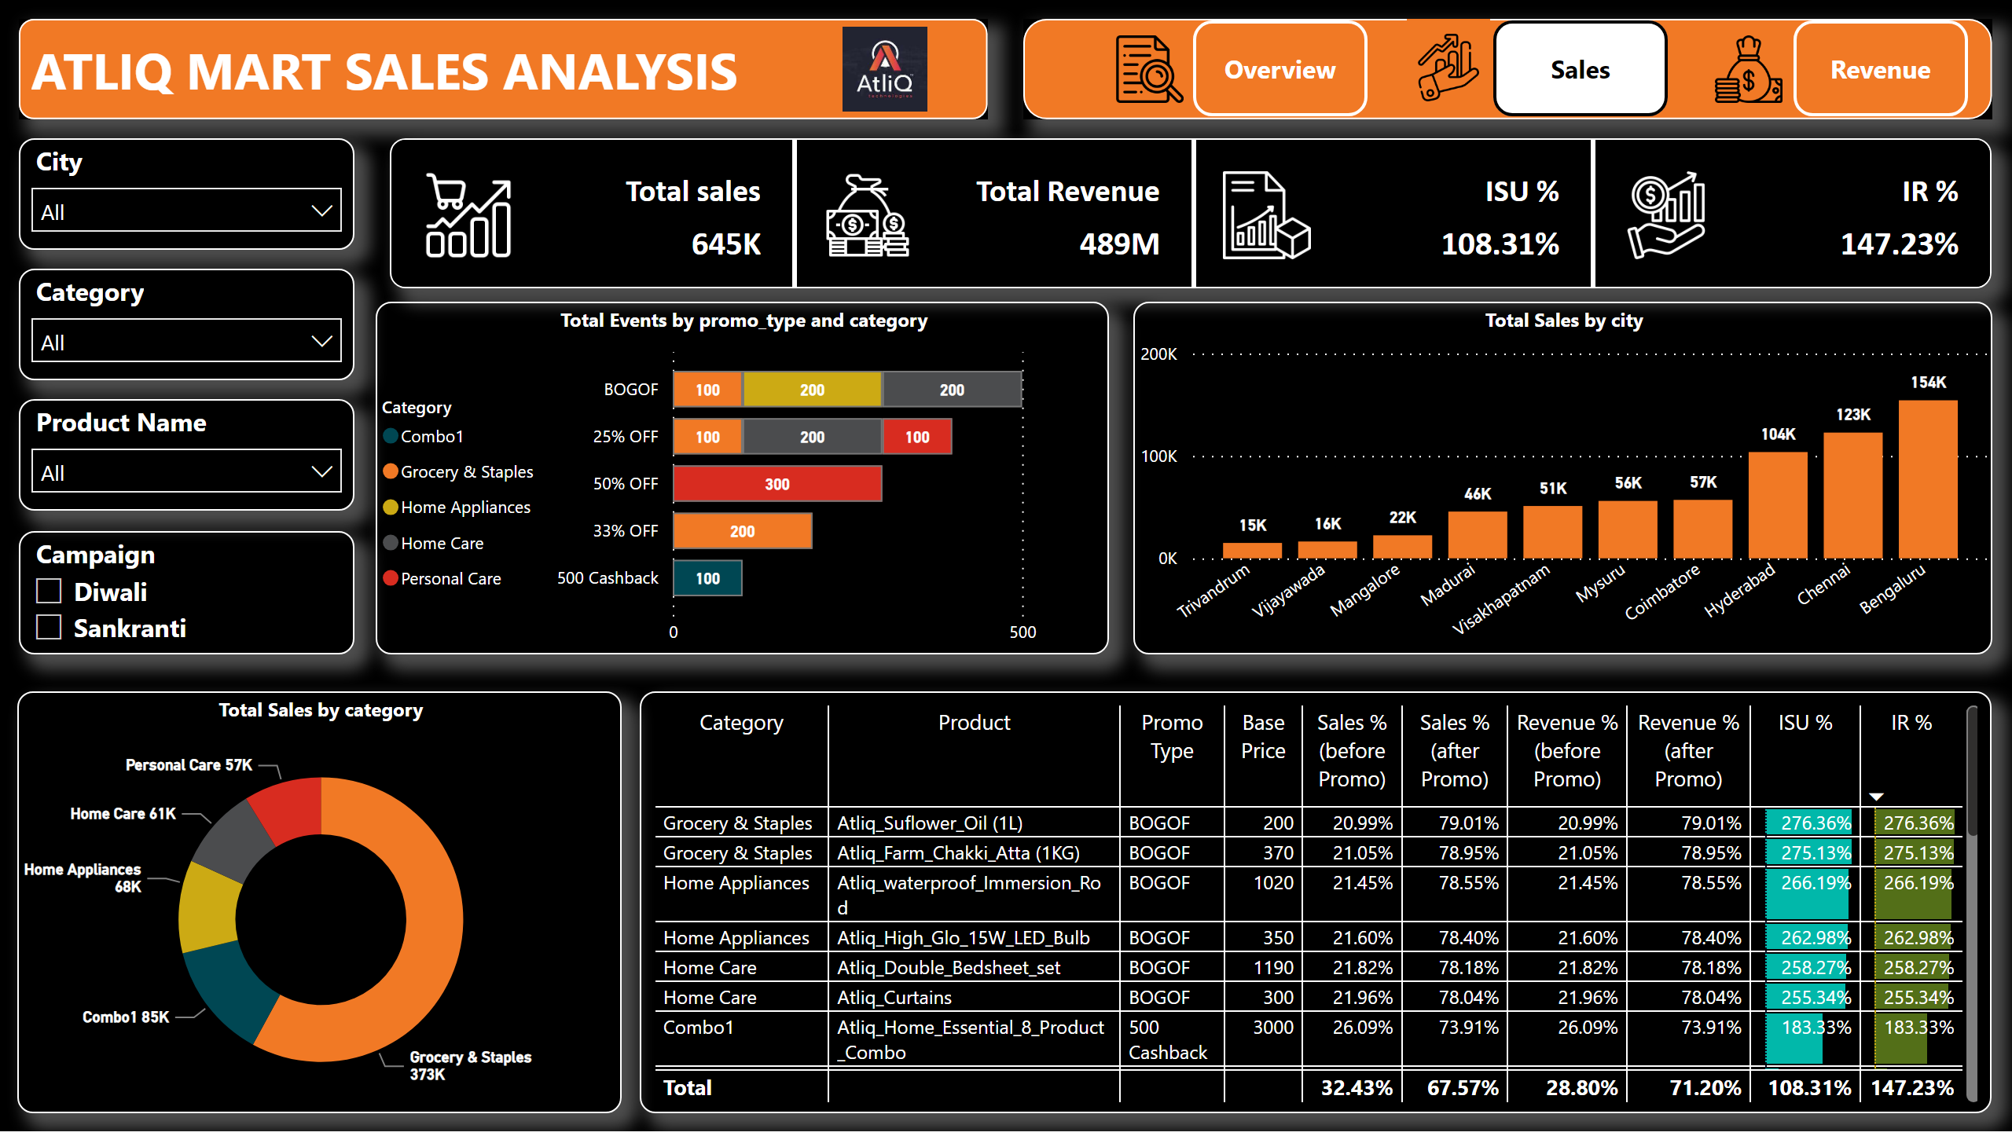

Slide 7
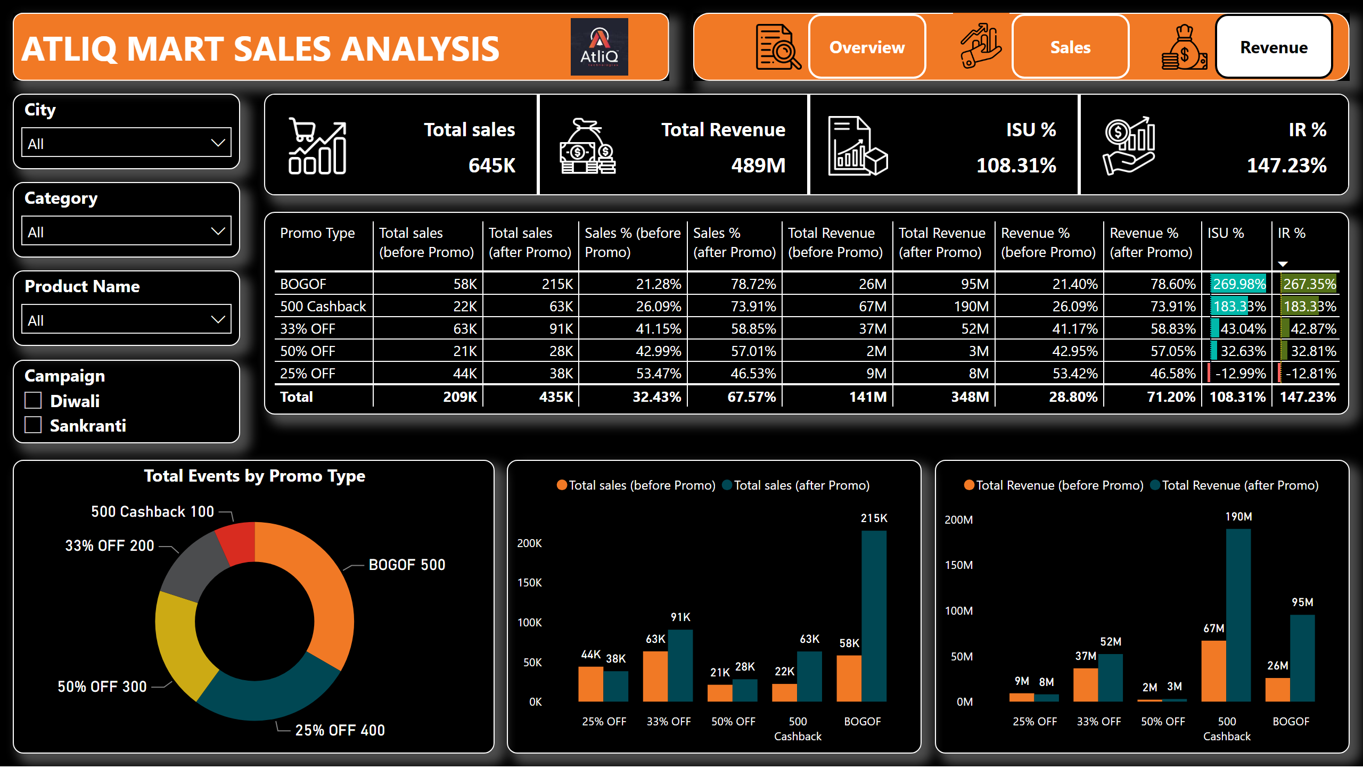

Slide 8

Ad-Hoc Business Requests

Slide 9
Business Requests 1
Within AtliQ Mart, the Double Bedsheet Set (₹1190) and Waterproof Immersion Rod (₹1020) stand out as high-value products, currently offered at significant discounts through 'BOGOF' promotions.

Slide 10
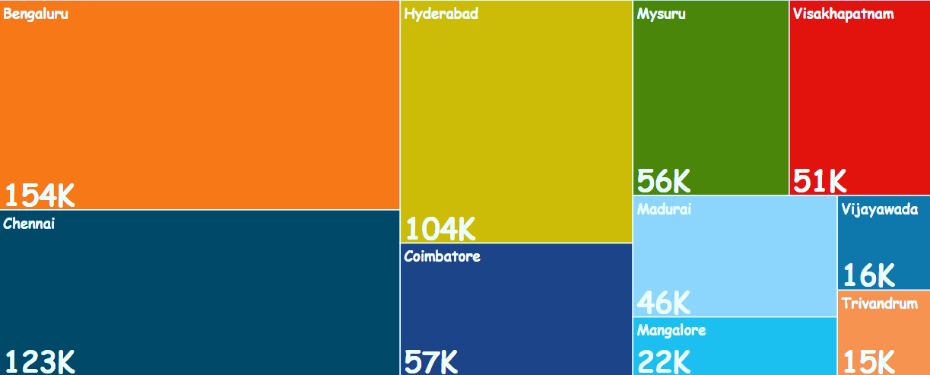
Business Requests 2
Bengaluru, Chennai, and Hyderabad, the top three cities, collectively make up 50% of the total stores in the southern region of India.
Total Sales in each Cities

Slide 11
Business Requests 3
During Diwali campaign, the total revenue surged from 83M to 207M after the promo, marking a remarkable 151% increase.
In the Sankranti campaign, total revenue jumped from 58M to 140M post-promo, showing a notable 141% boost.

Slide 12
Business Requests 4
ISU% measures the percentage change in items sold after a promotion compared to before the promotion.
ISU% for each category during the Diwali campaign
ISU% - Incremental Sold Quantity Percentage

Slide 13
Business Requests 5
IR% indicates the percentage difference in revenue after a promotion versus before the promotion.
Top 5 products in terms of IR% value across all campaigns
IR% - Incremental Revenue Percentage

Slide 14
Insights
Bengaluru, Chennai, and Hyderabad are the top cities with the highest number of stores, collectively representing 50% of the total stores in the southern region of India.
Total sales and revenue in Bengaluru, Chennai, and Hyderabad collectively contribute to more than 58% of the total sales and revenue in the southern region of India.
Within the AtliQ Mart, the Double Bedsheet Set and Waterproof Immersion Rod are the high-value products having base price more than ₹ 1000/- offered at significant discounts through 'BOGOF' promotions.
The Diwali and Sankranti campaigns resulted in substantial revenue increases, with revenue surging by 151% and 141% respectively.
Home Appliances and Combo1 categories experienced the highest ISU% i.e. 244% & 202% respectively, indicating a significant increase in sales during the Diwali campaign.
The Waterproof Immersion Rod, High Glo LED Bulb, Double Bedsheet set, Curtains and Home Essential 8 Product Combo are the top 5 products in the AtliQ Mart, generated substantial incremental revenue (IR%) percentages across all campaigns.

Slide 15
Recommendations
Focus on optimizing retail operations in Bengaluru, Chennai and Hyderabad cities to maximize profitability, while also exploring expansion opportunities in other promising cities.
Given the significant contribution from top 3 cities i.e. in Bengaluru, Chennai & Hyderabad, focus on customer engagement, retention strategies, and operational efficiency to further boost sales and revenue.
Consider leveraging similar promotions for other high-value products to stimulate sales and attract customers.
Continue investing in impactful promotional campaigns during festive seasons and analyze campaign strategies to replicate success in future campaigns.
Allocate resources and marketing efforts towards categories with higher ISU% to capitalize on seasonal demand and maximize incremental sales.
Prioritize the top-performing products in promotional activities and ensure sufficient stock availability to meet increased demand.

Slide 16
Thank You

